Slide 1
Wideband Photometry of the planets
Richard W. Schmude, Jr.
Gordon State College

Slide 2
Overview
Introduction
Materials and method
Results
Discussion and conclusions

Slide 3
Purpose of work
No previous measurements for the brighter planets for J and H
Clues about hazes/clouds on Jupiter/Saturn
Transparency of Venus’ atmosphere ?
Difference in North-south side of Saturn’s rings

Slide 4
Introduction
Light: electric and magnetic waves
Wavelength: length of one wave
Different colors have different wavelengths
Our eye can only see visible light

Slide 5
Introduction
Color | Wavelength (micrometers)
Blue | 0.45
Green | 0.55
Yellow | 0.59
Red | 0.65

Slide 6
Introduction
Filter | Wavelength range (micrometers)
J | 1.1 to 1.4
H | 1.5 to 1.8

Slide 7
Factors which may affect brightness
Distances
Solar phase angle
Ring tilt angle
Temperature

Slide 8
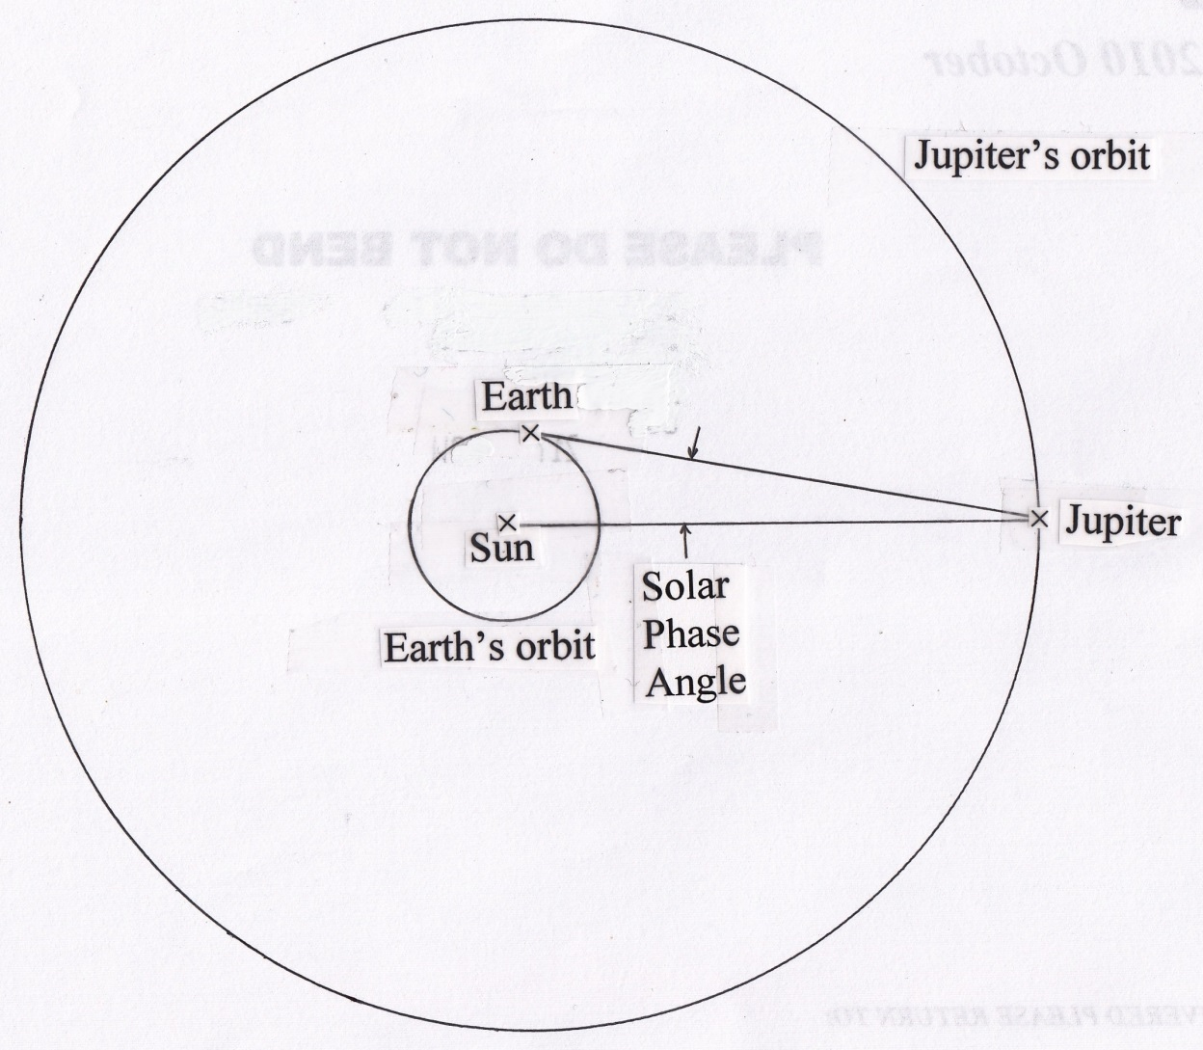
Solar phase angle

Slide 9
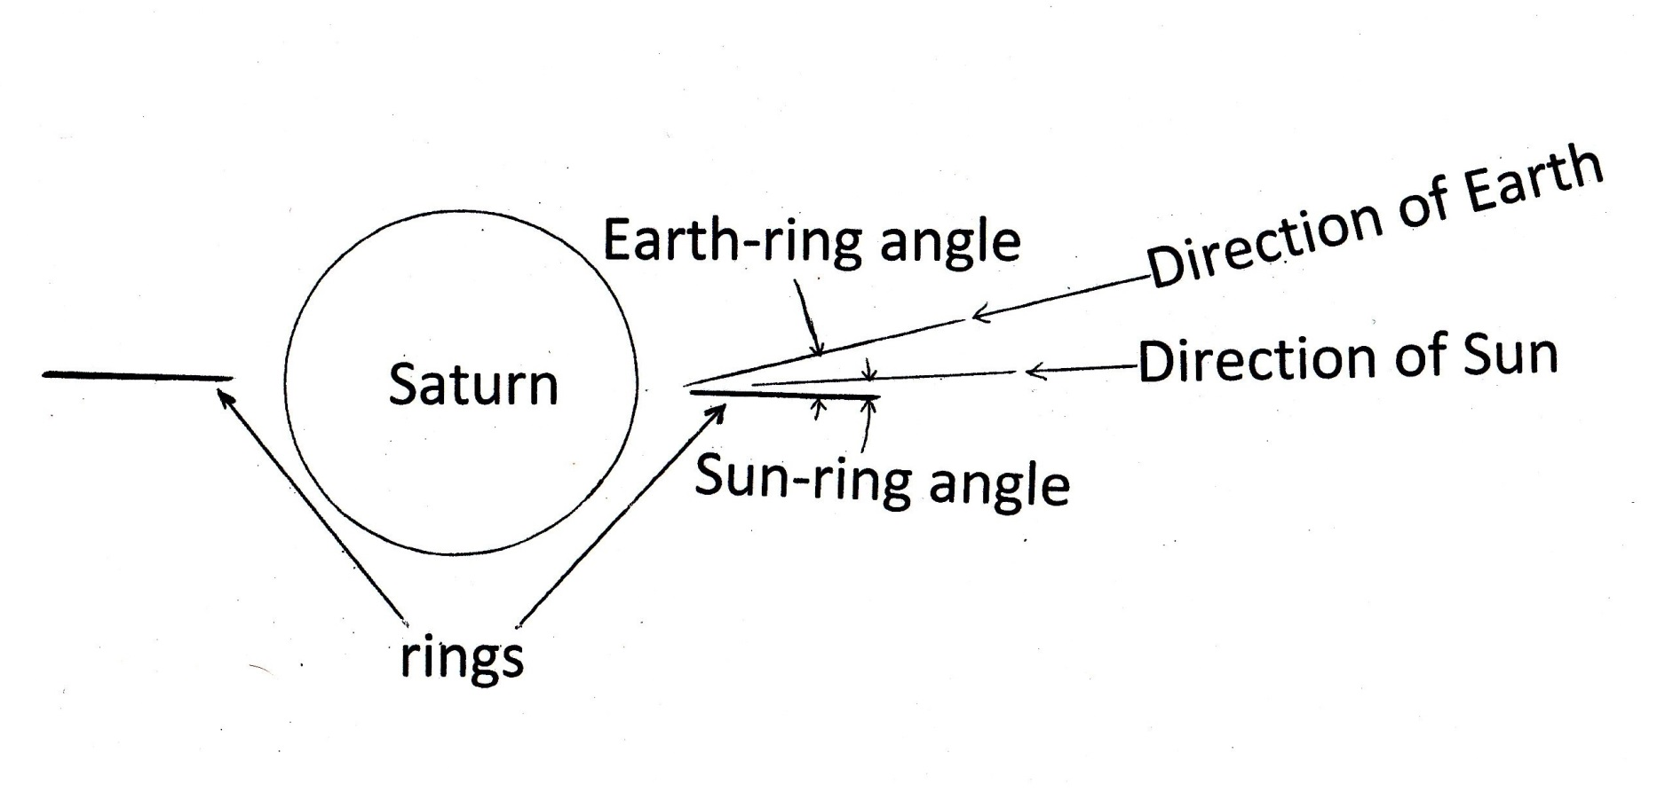
Ring tilt

Slide 10
Magnitude and color index
Star brightness in magnitudes
V – J = V magnitude minus J magnitude
If V – J > 0 the object is brighter in J than V

Slide 11
Voting Question
Please rank the planets from brightest to dimmest in visible light.
A. Jupiter, Mars, Mercury
B. Jupiter, Mercury, Mars
C. Mars, Jupiter, Mercury
D. Mercury, Jupiter, Mars
E. Mercury, Mars, Jupiter

Slide 12
Voting Question
Please rank the planets from brightest to dimmest in the H filter.
A. Jupiter, Mars, Mercury
B. Jupiter, Mercury, Mars
C. Mars, Jupiter, Mercury
D. Mercury, Jupiter, Mars
E. Mercury, Mars, Jupiter

Slide 13
Voting Question
A planet has a V – J of 1.0. This means that it is 1.0 magnitude brighter in the V filter than in the H filter.
A. True
B. False

Slide 14
Method & Materials
Celestron CG-4 Mount
0.09 m (3.5 inch) Maksutov
SSP-4 Photometer
AC extension cord

Slide 15
Method & Materials
Measure sky brightness
Measure Comparison star
Measure sky brightness
Measure target
Repeat 2 ½ more times

Slide 16
Results: V, R and I values
Carried out in early 2014
The V results for Mars
Up to 0.2 mag. brighter than in almanac
Close to expected value Mallama (2007)
The R and I values for Saturn are brighter than expected. North side of ring is brighter ?

Slide 17
Results: J and H
Measurements made in April-June 2014
Mercury, Venus, Mars, Jupiter and Saturn
Others did J and H measurements of Uranus and Neptune

Slide 18
Results (Number of measurements)
Object | V – J | V – H
Sun | 1.12* | 1.43
Mercury | --- | 2.29 (1)
Venus | 0.97 (2) | 1.04 (2)
Mars | 1.86 (24) | 2.18 (23)
Jupiter | 0.15 (18) | -0.28 (16)
Saturn + rings | 1.01 (18) | 0.80 (18)
Uranus + rings | -2.33 (10)** | -2.18 (10)**
Neptune + Triton | -1.87 (10)** | -1.72 (10)**

Slide 19
Results
Mars changes by 30 % as it rotates
Jupiter changes by less than 3% as it rotates

Slide 20
Conclusions
J and H color indexes have been measured for almost all of the planets
Mercury is very bright in H filter because its surface is very hot.
H filter light does not reach the surface of Venus

