Slide 1
Near-infrared photometry of Venus
Richard W. Schmude, Jr.
Gordon State College

Slide 2
Overview
Purpose of work
Introduction
Method and materials
Results
Conclusions

Slide 3
Purpose of work
Determine Near-IR photometric model
J filter (wavelength = 1.25 μm)
H filter (wavelength = 1.65 μm)
Look for changes

Slide 4
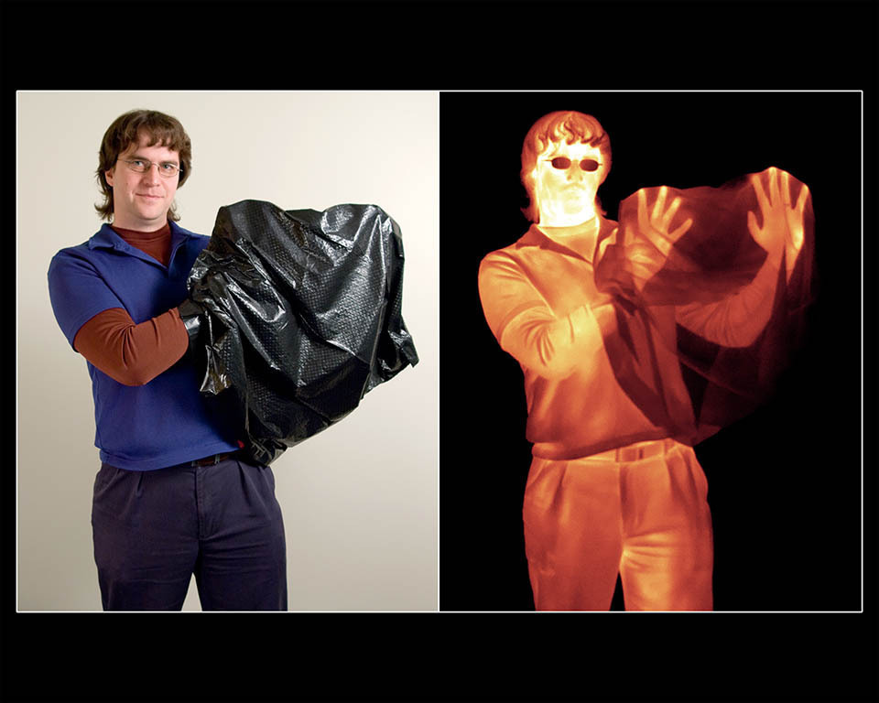
Introduction

Slide 5
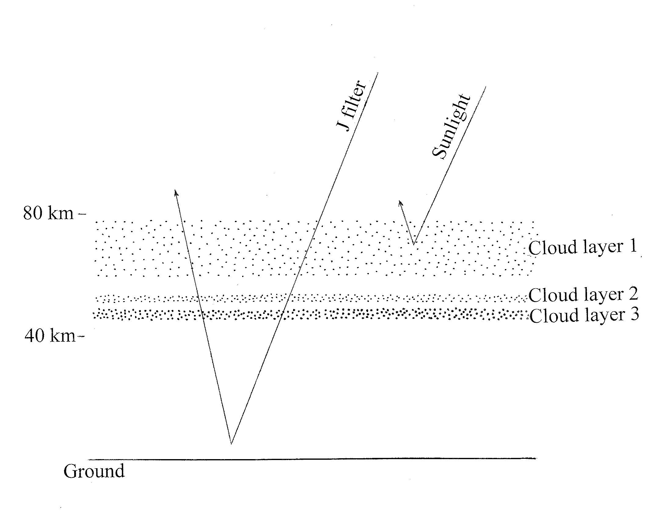
Introduction Modified from Taylor (2014) The Scientific Exploration of Venus

Slide 6
Introduction: penetration
J and H filters penetrate deep
Variation in lower clouds
Large scale meteorology
Super volcanoes?

Slide 7
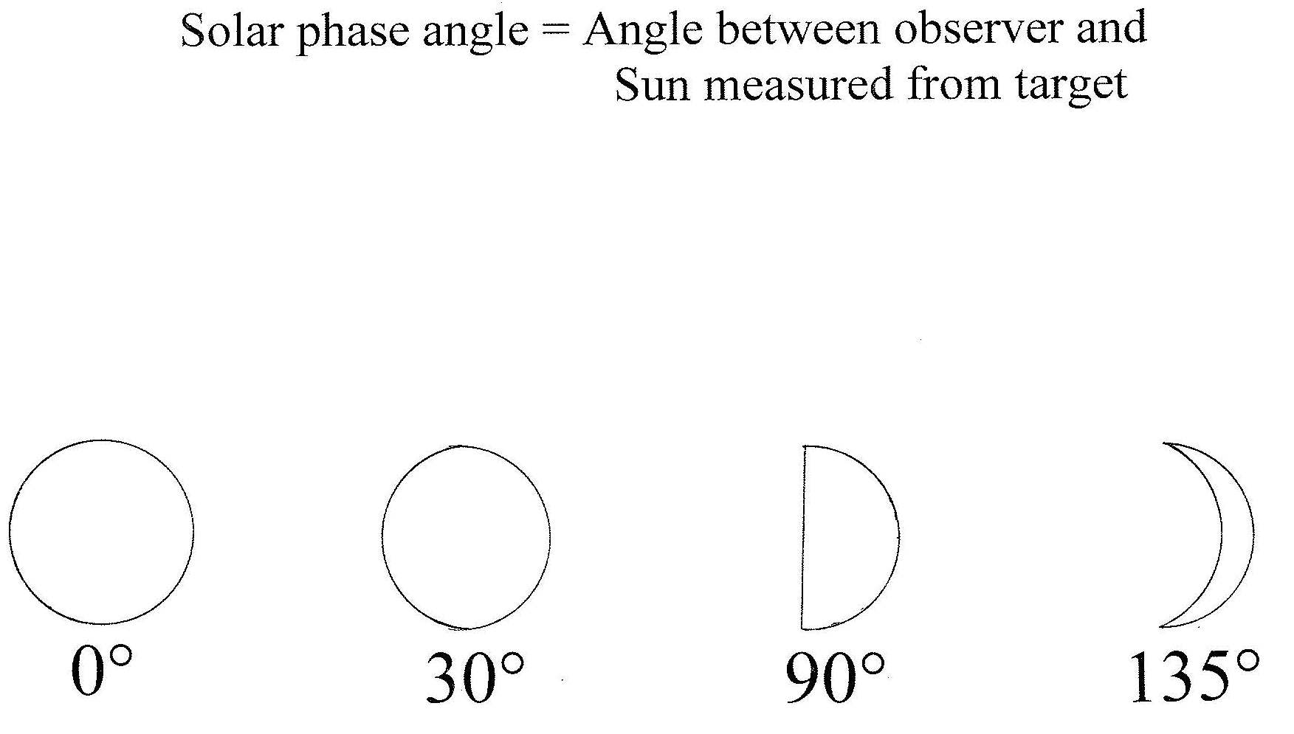
Solar phase angle

Slide 8
Magnitude system
Developed in ancient times
The higher the magnitude the fainter the object

Slide 9
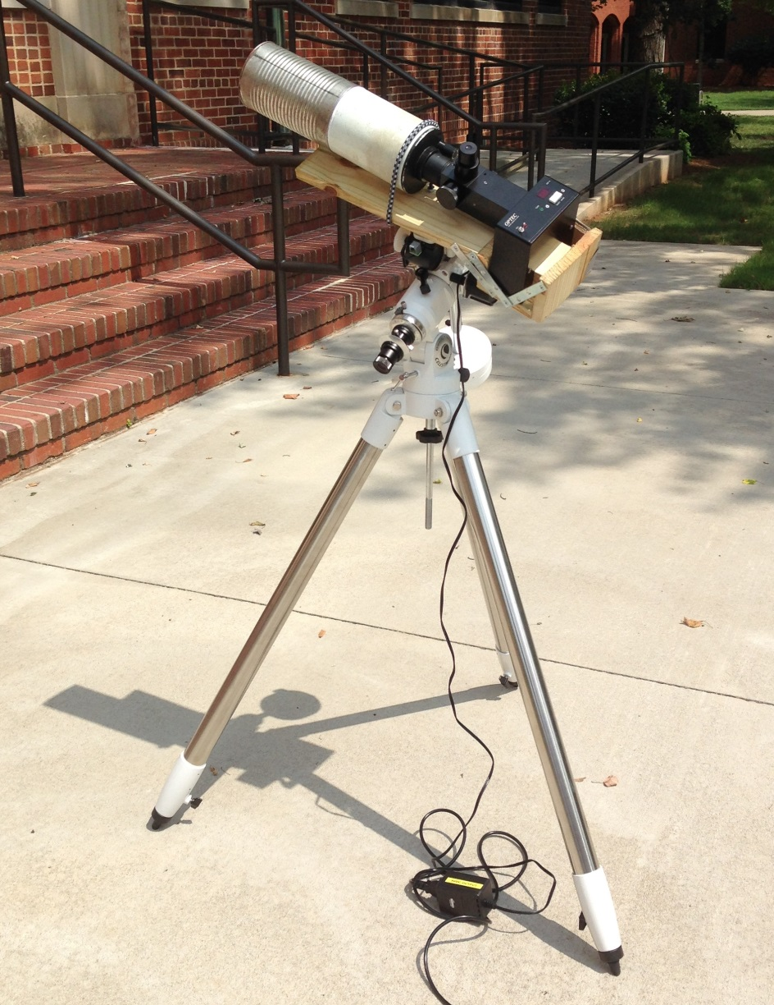
Equipment

Slide 10
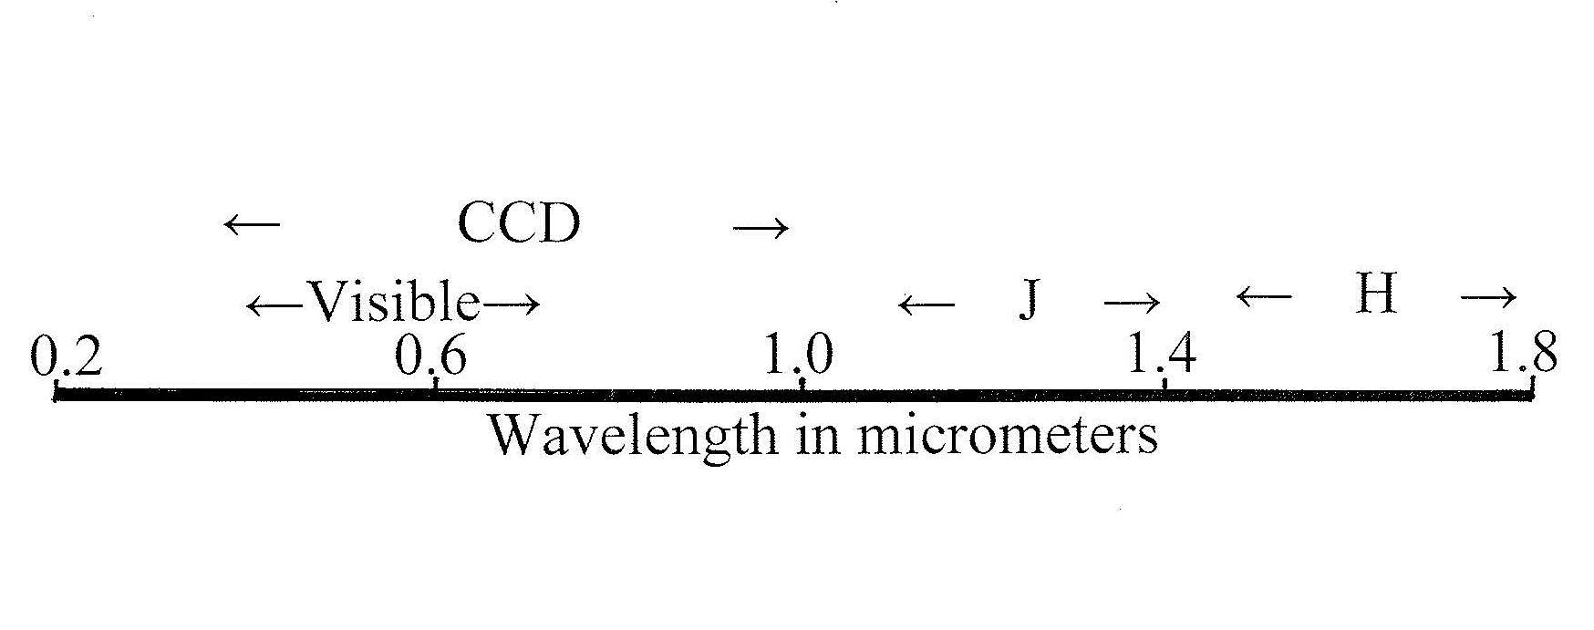
Wavelength

Slide 11
SSP-4 photometer
Filter wavelengths
J filter: 1.1 to 1.4 micrometers
H filter: 1.5 to 1.8 micrometers

Slide 12
Method
Measure comparison star
↓
Measure Venus
↓
Repeat 2 ½ more times
Star Magnitude: energy units

Slide 13
Voting Question
What is the purpose of this study?
a. Record near-infrared images of Venus
b. Monitor the near-infrared brightness of
Venus
c. Monitor the brightness of Venus in visible light
d. The purpose was not stated

Slide 14
Voting Question
What is the main instrument used in this study?
CCD camera
Near-infrared camera
Hubble Space Telescope
Gordon State College Observatory telescope
SSP-4 photometer

Slide 15
Results: H filter brightness

Slide 16
Results: J filter brightness

Slide 17
Results
Compute normalized brightness values
Venus-Sun distance = 1 astronomical unit
Venus-Earth distance = 1 astronomical unit
Astronomical unit = mean Earth-Sun distance

Slide 18
Normalized J(1,alpha) value
J(1,alpha) = J – 5.0 × LOG(r × Δ)
where: J = measured J magnitude
r = Venus-Sun distance in au
Δ = Venus-Earth distance in au

Slide 19
H filter normalized magnitude

Slide 20
J filter normalized magnitude

Slide 21
Voting Question
As time progressed between January and early July, the normalized magnitude of Venus (J or H filter) _____________.
a. dropped
b. rose
c. remained the same

Slide 22
Voting Question
As time progressed between January and early July of 2015, the measured brightness of Venus ________________.
dropped
rose
remained the same

Slide 23
Voting Question
As the solar phase angle of Venus rises, the normalized magnitude ___________.
a. rises
b. falls
c. remains the same

Slide 24
Albedos
Filter (Wavelength) | Venus | Mercury
V (0.55 μm) | 0.67 | 0.132
R (0.7 μm) | 0.69 | ---
I (0.9 μm) | 0.57 | ---
J (1.25 μm) | 0.60 | 0.22
H (1.65 μm) | 0.42 | 1.00

Slide 25
Albedos

Slide 26
Sources of Near IR radiation
Reflected sunlight
Thermal emission

Slide 27
Conclusions
Preliminary brightness models constructed
J and H filters do not penetrate to the surface
Small variations

Slide 28
Acknowledgements
R. Schmude would like to thank Gordon State College for a faculty development grant in 2014.
V, R and I albedos of Venus are from Mallama (2006) Icarus 182, p. 10.
V albedo of Mercury is from Mallama (2002) Icarus 155, p. 253.

